Slide 1
Rahoitus ja budjetointi
LIFE SIP hakemusvaihe
Kata Kreft-Burman
SYKE – EU tiimi
17.8.21

Slide 2
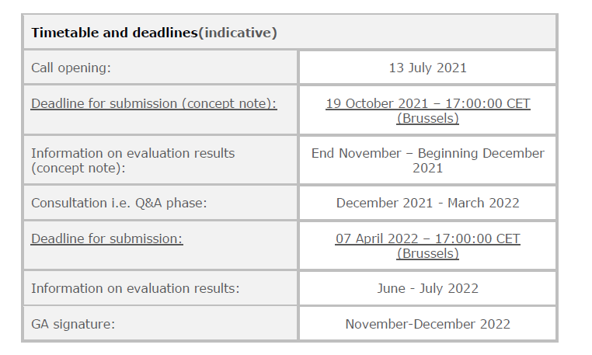
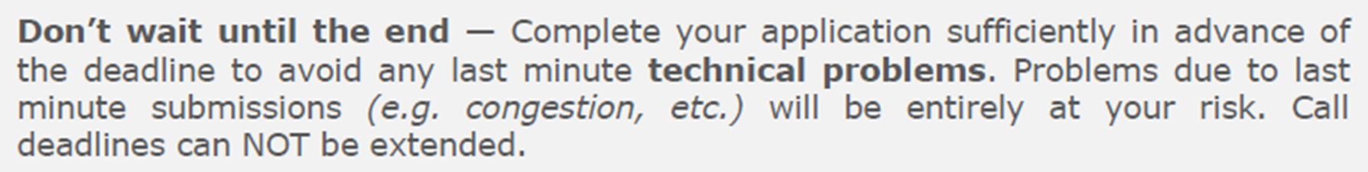
Aikataulu

Slide 3
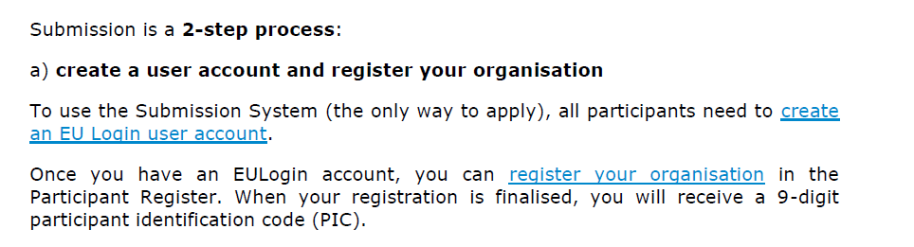
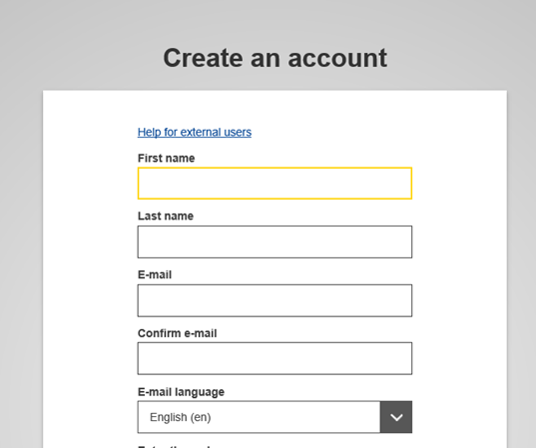
PM’s – create a user account
https://webgate.ec.europa.eu/cas/eim/external/register.cgi

Slide 4
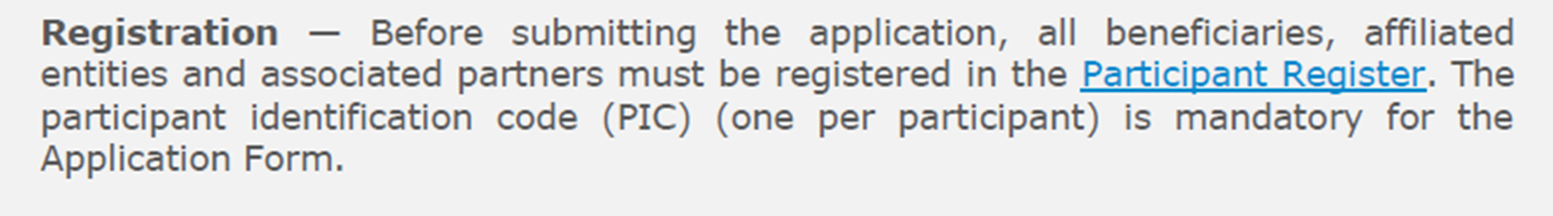
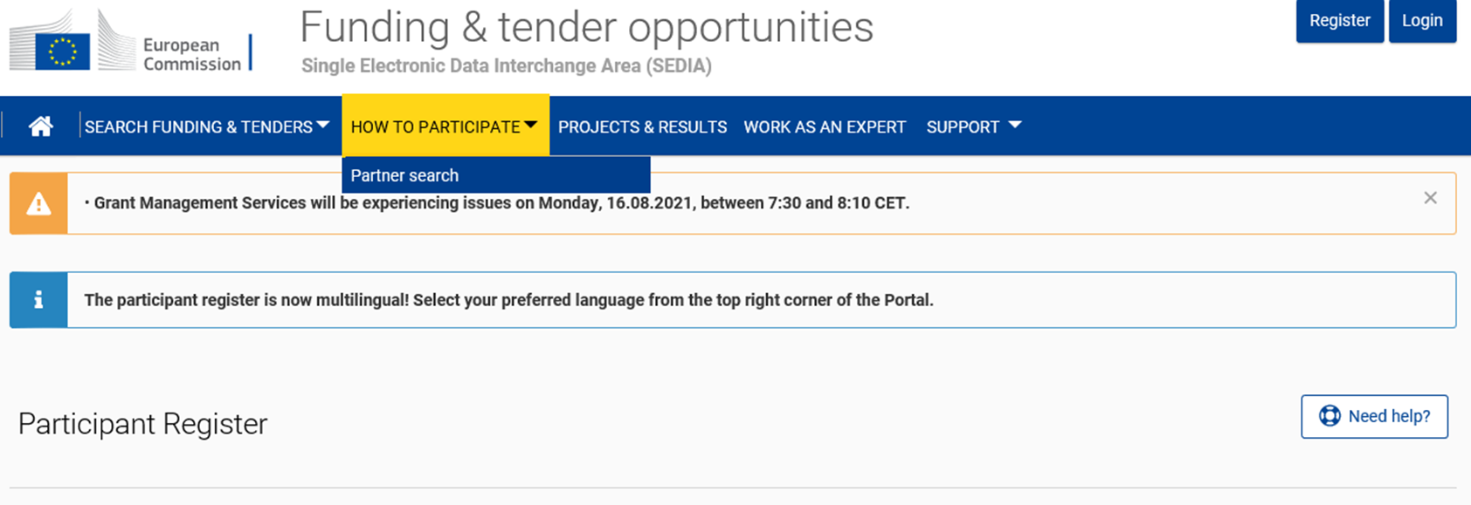
Kaikki partnerit – rekisteröinti/ PIC-numero
https://ec.europa.eu/info/funding-tenders/opportunities/portal/screen/how-to-participate/participant-register

Slide 5
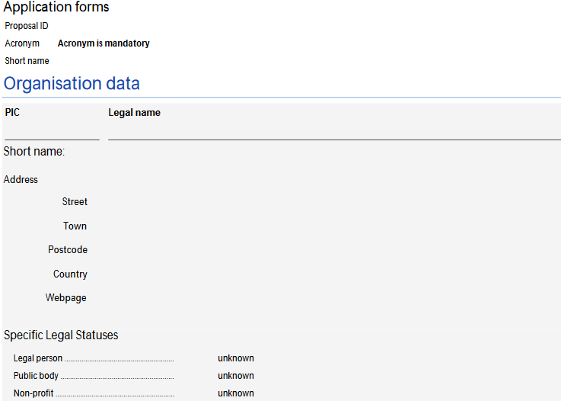

Slide 6
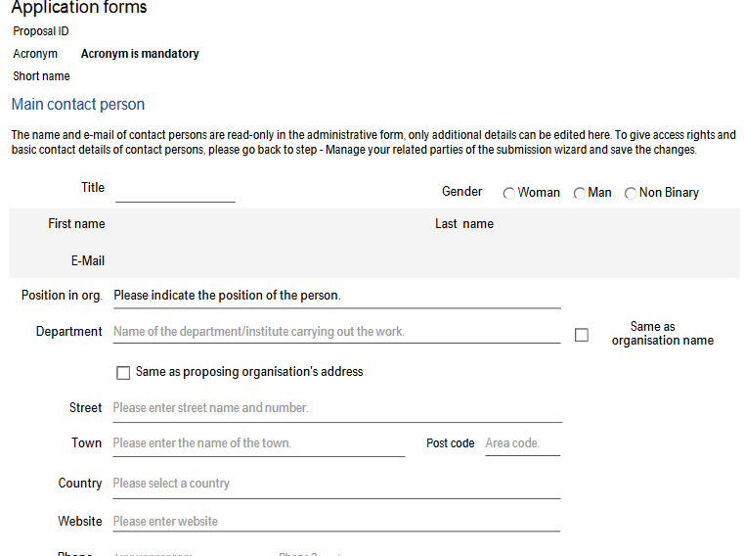

Slide 7
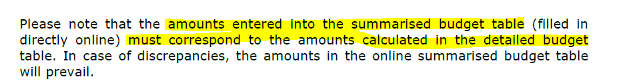
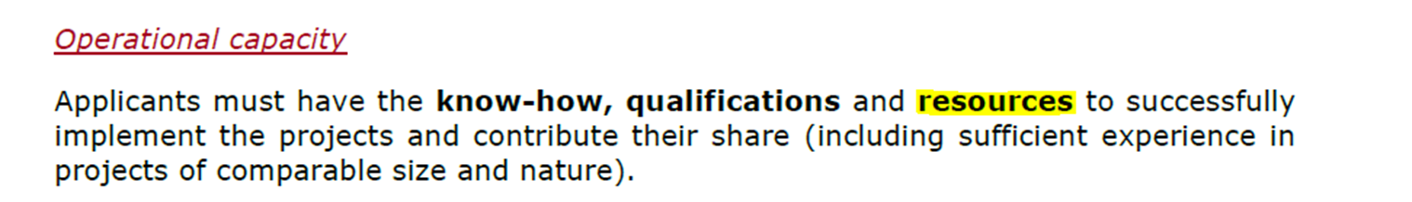
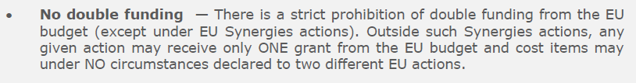
Budjetti – Part A – tehdään portaalissa

Slide 8
Budjettirakenne – full proposal 2020
Personnel (daily rates/ number of days = cost per person)
Travel and subsistence (trips inside the country; in Europe; outside Europe)
External assistance ( max 30% of the budget)
Durable goods (infrastructure, equipment – depreciation; prototype – 100% of the cost)
Consumables
Other costs (conference fees, guest speaker’s costs, translations)
Overheads – 7%
2% rule - removed

Slide 9
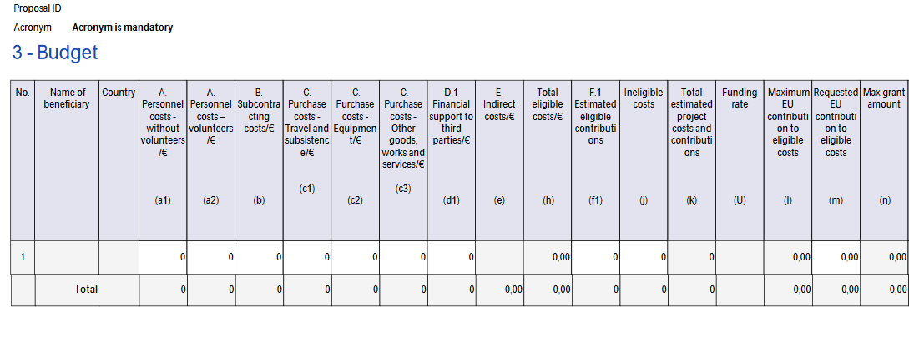

Slide 10
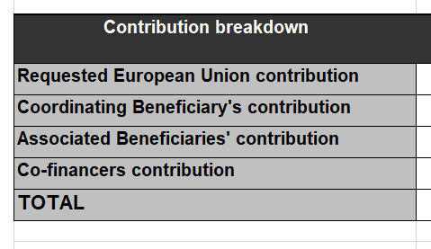
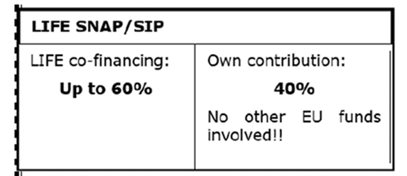
Contribution breakdown

Slide 11
Miten jatketaan?
Kysymyksiä talousasioista Katalle –
kata.kreft-burman@syke.fi
Koulutus – viikko 36 ( 2 sessiota) – kutsu tulossa ensi viikolla

